Slide 1
BANK ATM MACHINE
DENISH KALARIYA(18BIT016)(Leader)
MAULIK SAVALIA(18BIT065)

Slide 2
PROBLEM ABSTRACT
The project entitled ATM system has a drastic change to that of the older version of banking system, customer feel inconvenient with the transaction method as it was in the hands of the bank employees.
In our ATM system, the above problem is overcome here, the transactions are done in person by the customer thus makes the customers feel safe and secure.

Slide 3
Thus the application of our system helps the customer in checking the balance and transaction of the amount by validating the pin number therefore ATM system is more users friendly.
The ATM System is the project which is used to access their bank accounts in order to make cash withdrawals. Whenever the user need to make cash withdraws, they can enter their PIN number (personal identification number) and it will display the amount to be withdrawn in the form of 50’s, 100’s and 500’s. Once their withdrawn was successful, the amount will be debited in their accountecure.

Slide 4
The ATM will service one customer at a time. A customer will be required to enter ATM Card number, personal identification number (PIN) – both of which will be sent to the database validation as a part of each transaction. The customer will then be able to perform one or more transactions. Also customer must be able to make a balance inquiry of any account linked to the card.

Slide 5
The ATM will communicate each transaction to the database and obtain verification that it was allowed by the database. In the case of a cash withdrawal, a second message will be sent after the transaction has been physically completed. If the database determines that the customer’s PIN is invalid, the customer will be required to re-enter the PIN before a transaction can proceed

Slide 6
If a transaction fails for any reason other than an invalid PIN, the ATM will display an explanation of the problem, and will then ask the customer whether he/she wants to do another transaction.

Slide 7
INTRODUCTION
Automated Teller Machine enables the clients of a bank to have access to their account without going to the bank. This is achieved only by development the application using online concepts.

Slide 8
When the project is implemented, the user who uses this project will be able to see all the information and services provided by the ATM, when he enters the necessary option and arguments. The product also provides services like request for cheques, deposit cash and other advanced requirement of the user. The data is stored in the database and is retrieved whenever necessary. The implementation needs ATM machine hardware to operate or similar simulated conditions can also be used to successfully use the developed product.

Slide 9
To develop this ATM the entire operation has been divided into the following step:
Verification process
Language, service and account selection
Banking services
Transactions
Special services

Slide 10
The program is designed in such a way that the user has to enter card or pin number. Once verified, he is provided a menu and he/she had to enter the option provided in the menu.
It also give facilities like transfer the money from one account number to another and also fast cash and get cash. which are very beneficial in emergency.

Slide 11
WELCOME TO THE ATM
Customer
Admin

Slide 12
Admin
Create an Account
Update Account
Delete Account
Search Account
View Report
Exit

Slide 13
Create Account
Enter name
Select Type
(current or savings)
Enter User Login
Select Status
(active or disable)
5 Digit
Pin code
Starting Balance
Message box::- Account created Successfully…..

Slide 14
Update Account
options
1.Account Number 2.Holder’s Name 3.Account type
Enter account number
Enter Holder’s Name
Enter Account type
Account | Name | Pin code | User login id | Balance | Status | Type | Date
Successfully updated!!!!

Slide 15
Delete Account
Enter Account Number You want to delete
Confirmation Warning with Holder’s Name
Re-Enter Account Number
Deleted Successfully!!!

Slide 16
Search Account
1.Search through Account Number
Enter account number
2.Search through Holder’s Name
Enter Holder’s Name
3.Search through Account Balance
4.Search through account type
Enter minimum balance
Enter Maximum Balance
Found
Not Found
EXIT
Account | Name | Pin code | User login id | Balance | Status | Type | Date

Slide 17
View Report
1.By Holder’s Name
Enter the Name
2.By Amount
3.By Account Type
minimum
maximum
Account | Name | Pin code | User login id | Balance | Status | Type | Date

Slide 18
Customer
Login
Not Registered
User Login id
Password

Slide 19
Customer
Deposit Cash
Transfer Cash
Withdraw Cash
Get Cash
Fast Cash
EXIT

Slide 20
Deposit Cash
Enter cash Amount you want to deposit
Successfully deposited!!
Warning :-
Print receipt
Warning box:
Account No:
Date:
Deposited :
Balance:
Yes
No

Slide 21
Transfer Cash
Enter the Amount
Not Found
Enter the amount number to which you want to transfer!!
Found
Warning
Re-Enter account number to which you want transfer number
Warning of confirmation
Print receipt
yes
No

Slide 22
Withdraw Cash
Enter amount you want to withdraw
Successfully Withdraw!!
Print Receipt
Warning Box:
Yes
No

Slide 23
GET CASH
Account information :
Account No:
Date:
Balance:

Slide 24
FAST CASH
Selection Box:
500
1000
2000
5000
10000
…
(till account balance)
Successfully Withdraw!!
Print Receipt
Yes
No

Slide 25
Details of Multithreading
Multithreading in Java is a process of executing multiple threads simultaneously. A thread is a lightweight sub-process, the smallest unit of processing.
In this java project Multithreading is used for the same purpose of executing multiple threads of the customer in such way that there will be no exception in implementing the threads and it can run multiple threads smoothly.

Slide 26
List of the components which are used
JTable
Jbutton
CheckBox
Warning Panel
JPanel
JButtonGroup
ArrayList
Calender
SimpleDateFormat
List

Slide 27
File Handling
There are no such files are used in this java project.
As we Execute the program the all the details of the customers get stored in the dynamic memory of the program and if we close the program all the stored data of the customers get erased from that memory .

Slide 28
Details of Program
Four main classes are there there:
ATM
ADMIN
CUSTOMER
Customer_Data
There are constructors for such classes
Many methods are used for whole program such like getcash(),withdrawcash(),Deposit(),etc..

Slide 29
Exception Handling
Inbuilt Exception methods are used in the java project
NumberFormatException
StringIndexOutOfBounds

Slide 30
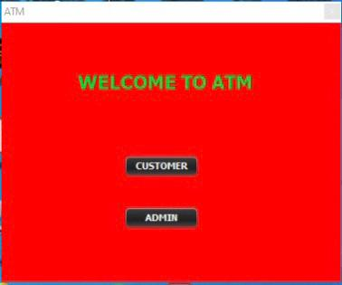
GRAPHICAL USER INTERFACE
Homepage:

Slide 31
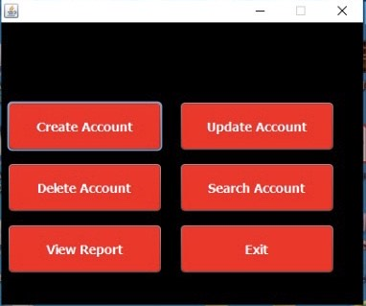
Admin :

Slide 32
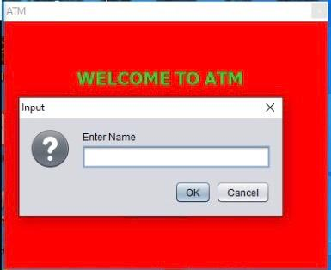

Create Account:

Slide 33

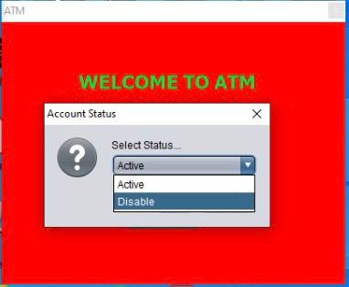
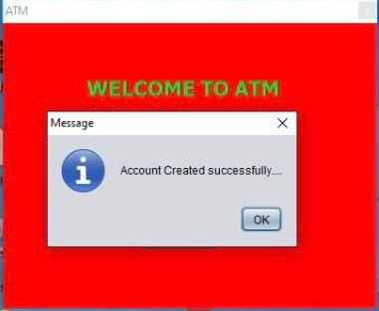
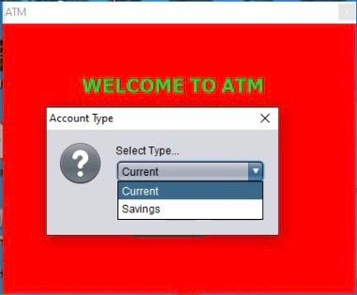

Slide 34
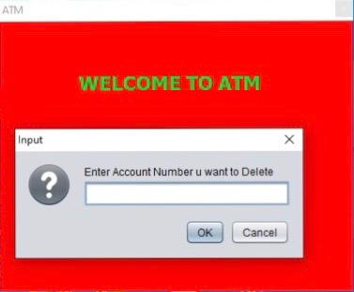
Delete Account:-

Slide 35
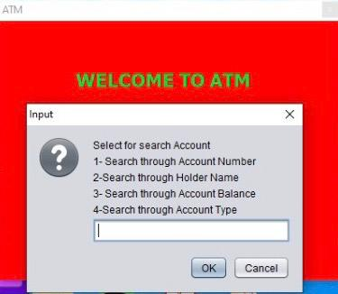
Search Account:

Slide 36
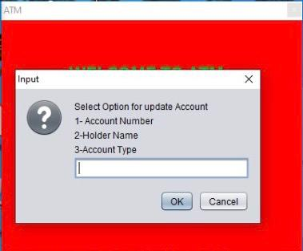
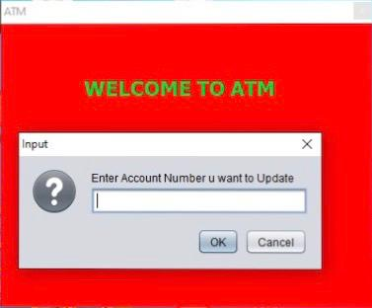
Update Account:-

Slide 37
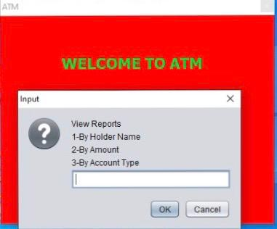
View Reports:

Slide 38
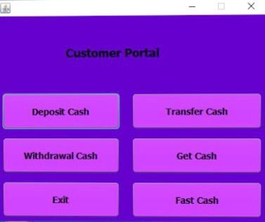
Customer Portal:-

Slide 39
THANK YOU !!!!!

